Slide 1


Slide 2

Diversity Training
Instructor:
Date:

Slide 3
OBJECTIVES
Objectives: (Classroom)
To provide a clear understanding of what diversity is and what it isn't.
To raise a greater awareness and sensitivity to Diversity issues that go well beyond the assumed categories.
To recommend behavioral tools for fostering a more cohesive workplace

Slide 4
OBJECTIVES
Method Of Instruction:
Lecture development
Training Aides:
Lecture
Pen and paper are required

Slide 5
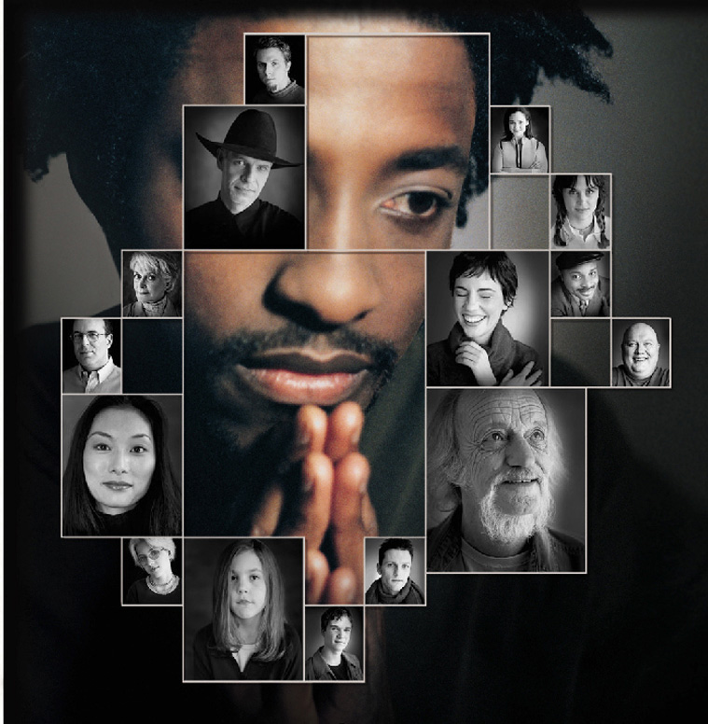
Diversity Defined
Diversity is the mosaic of people who bring a variety of backgrounds, styles, perspectives, values and beliefs as assets to the groups and organizations with which they interact.

Slide 6
Diversity
Distinction Between EEO, Affirmative Action and Diversity & Inclusion
Equal Employment Opportunity
The enforcement of statutes to prevent employment discrimination
Affirmative Action
The effort to achieve parity in the workforce through outreach and eliminating barriers in hiring
Diversity & Inclusion
Leveraging differences in the workforce to achieve better results

Slide 7
Diversity
Primary and Secondary Dimensions of Diversity
Geographic Organizational Role and Level
Location Communication Style
Military Experience Family Status
Work Experience Work/thinking Style
Socioeconomic status Education
Religion Age
First Language Gender
Sexual Orientation Disability
Ethnic Heritage Race

Slide 8
Diversity
All Communication is Filtered Through Your Cultural Perspective
Age Geographic location
National origin Functional discipline
Race Languages used
Sexual orientation Values
Religion Communication style
Disability Work Style
Gender Learning style
Education Economic status
Work role/experience Family situation
Personality Military experience
Customs Philosophical perspective

Slide 9
Diversity
A New Metaphor for Canadian Culture
The “melting pot” theory of Canadian society has evolved, instead consider a vegetable soup metaphor.
You can easily identify and taste the unique flavors of the individual parts.
Members of various cultural groups may not want to be assimilated, they want their tastes, looks and texture to remain whole.
To reap the business benefits of diversity, you must employ inclusive work strategies

Slide 10
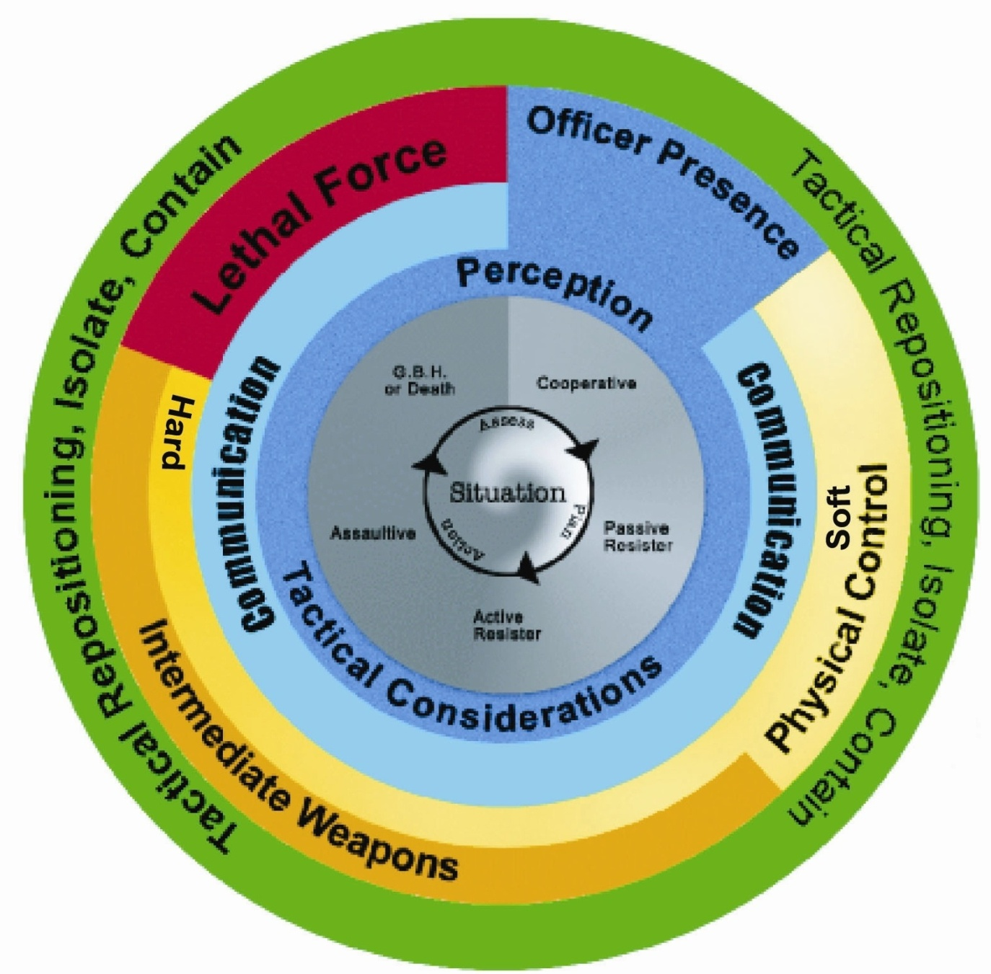
Use of Force Framework

Slide 11
Use of Force Framework
1. Our primary responsibility is to preserve life
2. Any use of force is designed to ensure public safety.
3. The Framework does not replace the law, the law speaks for itself.
5. Designed based on current federal statutes and current case law.
6. The Framework is not intended to dictate policy to any agency.

Slide 12
Use of Force Framework
The Framework is designed to be simple to understand and relate to public and security agencies alike.
The thought behind the Framework is based on the theory of Subject Resistance and Officer Control
The ideal outcome is to control the behavior, end violence, and surrender subjects to the Police.

Slide 13
Legal Issues – Use of Force
Section 25 (1)
Protection of persons acting under authority
(1)Everyone who is required or authorized by law to do anything in the administration or enforcement of the law
as a private person,
(c) In aid of a peace officer or public officer
is, if he acts on reasonable grounds, justified in doing what he is required or authorized to do and in using as much force as is necessary for that purpose.

Slide 14
Legal Issues – Use of Force
Section 25 (3)
When not protected
Subject to subsections (4) and (5), a person is not justified for the purposes of subsection (1) in using force that is intended or is likely to cause death or grievous bodily harm unless the person believes on reasonable grounds that it is necessary for the self-preservation of the person or the preservation of any one under that person’s protection from death or grievous bodily harm.

Slide 15
Legal Issues – Use of Force
Section 26
Excessive Force
Taking into account all sections, which govern using force, this section covers excessive force. Everyone who is authorized by law to use force is criminally responsible for any excess thereof.
Anyone using force must be able to justify his or her actions. If there is no lawful justification for using force or more force is used than is necessary, then the law enforcement officer may be subject to criminal and/or civil liability.

Slide 16
Legal Issues – Use of Force
Section 27
Use of force to prevent commission of an offence
Justifies everyone in using as much force as is reasonably necessary to prevent the commission of an offence.

Slide 17
Legal Issues – Self Defense
Section 34
A person is not guilty of an offence if;
(a) they believe on reasonable grounds that force is being used against them or another person or that a threat of force is being made against them or another person;

Slide 18
Legal Issues – Self Defense
Section 34
(b) the act that constitutes the offence is committed for the purpose of defending or protecting themselves or the other person from that use or threat of force; and
(c) the act committed is reasonable in the circumstances.

Slide 19
Legal Issues – Self Defense
Section 34
(2) In determining whether the act committed is reasonable in the circumstances, the court shall consider the relevant circumstances of the person, the other parties and the act, including, but not limited to, the following factors:

Slide 20
Legal Issues – Self Defense
Section 34
the nature of the force or threat;
(b) the extent to which the use of force was imminent and whether there were other means available to respond to the potential use of force;
(c) the person’s role in the incident;
(d) whether any party to the incident used or threatened to use a weapon;

Slide 21
Legal Issues – Self Defense
Section 34
(e) the size, age, gender and physical capabilities of the parties to the incident;
(f) the nature, duration and history of any relationship between the parties to the incident, including any prior use or threat of force and the nature of that force or threat;

Slide 22
Legal Issues – Self Defense
Section 34
(f.1) any history of interaction or communication between the parties to the incident;
(g) the nature and proportionality of the person’s response to the use or threat of force; and
(h) whether the act committed was in response to a use or threat of force that the person knew was lawful.

Slide 23
Legal Issues – Self Defense
“Grievous bodily harm”
Means, a bodily injury that creates a substantial risk of death, causes serious permanent disfigurement, or results in long-term loss or impairment of the functioning of any bodily member or organ.

Slide 24
Legal Issues – Self Defense
Section 37
Preventing Assault
(1) Justifies everyone to use force to defend themselves or anyone under his protection from assault, if they use no more force than is necessary.

Slide 25
Legal Issues – Citizens Arrest
494. (1) Anyone may arrest without warrant
(a) a person whom he finds committing an indictable offence; or
(b) a person who, on reasonable grounds, he believes
(i) has committed a criminal offence, and
(ii) is escaping from and freshly pursued by persons who have lawful authority to arrest that person.

Slide 26
Legal Issues – Citizens Arrest
Arrest by owner, etc., of property
(2) Anyone who is
the owner or a person in lawful possession of property, or
(b) a person authorized by the owner or by a person in lawful possession of property,
may arrest without warrant a person whom he finds committing a criminal offence on or in relation to that property.

Slide 27
Legal Issues – Citizens Arrest
Delivery to peace officer
(3) Any one other than a peace officer who arrests a person without warrant shall forthwith deliver the person to a peace officer.

Slide 28
Use of Force - Factors
Three Elements of Effective Force:
Was it reasonable?
Was it necessary?
Was it non-aggressive?

Slide 29
Use of Force - Factors
Legal and effective methods of force occur when:
The method is reasonable
It is necessary
It is not overly aggressive under the circumstances presented

Slide 30
Use of Force - Factors
Reasonable
Was the level of force justified in controlling the subject?
Was the subject given a chance to comply without force?
Did the subject limit your ability to de-escalate?
With compliance by the subject, did the escalation of force become limited?

Slide 31
Use of Force - Factors
Necessary
The subject(s) did not obey commands
or control tactics.
Use of lower levels was not possible
or ineffective.
The subject presented a danger to the
officer or the public and must be
controlled to prevent further danger.

Slide 32
Use of Force - Factors
Officer Imposed Jeopardy
When an officer places themselves, or someone else in unreasonable danger when cover was available or they could have stayed out of the reach of the subject
Ex: Jumping in front of a car
Closing the distance on a subject
Goading a subject to fight
“Come on punch me– you get a free one”
You risk nullifying assault charges IF you place yourself in undue risk

Slide 33
Use of Force - Factors
Non-Aggressive
Did the officer use more force than was necessary, or did the use of force continue after control was achieved?
The officers actions/level or force was disproportionate to the need for action
The actions committed were based on aggression
The actions of the officer shock the conscience of the court

Slide 34
Use of Force - Factors
In order for security to use force, the aggressor MUST have these three elements:
Weapons / Means
Intent
Delivery System / Ability

Slide 35
Use of Force - Factors
Weapon
The subject can threaten with a weapon or reasonably appears capable of causing harm.
Some form of weapon must be present

Slide 36
Use of Force - Factors
Intent
The aggressor desires to cause harm to the officer or another.
Immediate vs. imminent
Now vs. future threats
I am shooting you vs. I am going to my car to get a gun to shoot you

Slide 37
Use of Force - Factors
Delivery System
The subject has the physical ability to carry out the threat.

Slide 38
Use of Force - Factors
There are a number of factors that we must consider when selecting a force option:
Is this the appropriate control response
is there a lower option?
Did I identify myself?
Did I reposition and allow the subject to
de-escalate?
Did I make a proper threat assessment before intervening?

Slide 39
Use of Force - Factors
Factors to consider for proper threat assessment:
Situation
Subject behavior / possible attack signs /threat cues
Perception
Environment
# of subjects
Knowledge of the subject
Subject demonstrated abilities
Time /distance from subject
Is your target isolated – what will you hit if you miss?

Slide 40
Use of Force – Levels of Resistance
Security’s use of force is based on control.
The level(s) of resistance exhibited by a subject determines the level of control used by the officer.
Control:
To influence or direct people's behavior or the course of events
Resistance:
The refusal to accept or comply with something (can be verbal or physical)

Slide 41
Use of Force – Levels of Resistance
Levels of resistance are shown in the second inner circle of the Force Options Theory diagram.
Although categorized for easy recognition, it is accepted that resistance levels will frequently overlap and can’t be categorized precisely.
Cooperative
Passive Resistance
Active Resistance
Assaultive
Grievous Bodily Harm or Death

Slide 42
Use of Force – Levels of Resistance
Cooperative (white) –
Commonly known as a “Yes” person. This individual obeys all lawful orders and direction by an officer.
Passive Resistance (light gray) –
This individual does not physically interfere with an officer’s attempt at control, but does nothing to assist. Common examples of this resistance would be “dead-weight”, a “sit-in” protest, and the body going limp, refusing to leave an area and not obeying a lawful order.

Slide 43
Use of Force – Levels of Resistance
Active Resistance (gray) -
This individual doesn’t physically assault the officer, but actively resists in such a manner that won’t allow the officer to control. Often accompanying this type of resistance is “Verbal Non-Compliance” (refusing a lawful order or direction).
Examples of this resistance are pulling away from the officer or attempting to flee.

Slide 44
Use of Force – Levels of Resistance
Assaultive (dark gray) –
This individual not only resists a Law Enforcement Officer’s action, but also actually attempts to physically assault the officer.
This type of resistance is sometimes preceded by “pre-assault” cues, commonly known as “Psychological Intimidation” (clenching of fists, facial expressions, threats, etc.), and verbal non-compliance.
Note: An officer would be justified to respond physically even against “pre-assault ” cues.

Slide 45
Use of Force – Levels of Resistance
Grievous Bodily Harm or Death (black) –
This individual violently resists. The resistance level exhibited attempts to cause grievous bodily harm or death the officer.
Examples of these actions are a subject attempting to disarm a law enforcement officer where the officer fears grievous bodily harm or death or an attack with weapon the officer fears grievous bodily harm or death from.

Slide 46
Use of Force – Force Options
The Use of Force Framework identifies
5 options for force:
Officer Presence
Tactical communication
Physical Control
Intermediate Weapons
Lethal Force

Slide 47
Use of Force – Force Options
Officer Presence (blue) –
Appearance, uniform, reputation, physical stature, number of officers.
Many people do not feel that presence is a force option, but in actual fact, a law enforcement officer’s mere presence often influences or controls a person’s behavior.

Slide 48
Use of Force – Force Options
Tactical Communication (green) –
(Dialogue) verbal skills in conjunction with non-verbal skills. Suggestions, advice, directions continuing through to loud, repetitive commands, in conjunction with facial expressions, stance, eye contact, etc.
Dialogue is used continually with the rest of the force options. In fact, an extremely high percentage of all encounters with offenders are resolved at this level.

Slide 49
Use of Force – Force Options
Physical Control Soft / Hard (yellow)
Sub-levels of force within empty hand option:
Escort Position
(implied force)
Superior Physical Strength
(size or numbers)
Balance Displacement Techniques
(throws, takedowns)

Slide 50
Use of Force – Force Options
(cont’d)
Pain Compliance Techniques
(joint locks, pressure points, hair control, etc.)
Empty Hand or Weaponless Impact
(stuns, strikes & kicks, using various parts of the body)
Lateral Neck Restraint
(rendering a subject unconscious through pressure to the sides of the neck resulting in a lack of oxygenated blood to the brain).
LNR is the highest level of physical control.

Slide 51
Use of Force – Force Options
Generally speaking, physical control (or empty hand) means any physical technique the officer uses to control the subject that does not involve the use of a weapon.
Soft techniques are control-oriented and have a lower probability of causing injury. These techniques typically rely upon pain compliance such as restraining techniques, pressure points and joint / arm locks. Handcuffing would also be included in this category. These techniques are generally applicable to a subject exhibiting passive resistant and active resistant behavior.

Slide 52
Use of Force – Force Options
Hard techniques are intended to stop an aggressor’s behavior or to allow for the application of another control technique. These physical tactics include such techniques as empty hand strikes, knee strikes, punches, kicks and neck restraints. Striking large muscle mass areas would be desired target areas; however, the totality of the circumstances would always be taken into account.
These techniques are generally applicable to a subject exhibiting behavior that the officer perceives as being active resistant to assaultive.

Slide 53
Use of Force – Force Options
Intermediate Weapons / Weapons of Opportunity (orange) –
Again there are various sub-levels in this force option. This option has relevance to modern day policing as technology is always inventing new methods for less than lethal force. Attempting to categorize each intermediate weapon would be confusing and unnecessary, as the Atlantic Police Academy Use of Force Model would become lengthy and constantly changing. This option represents an intermediate group of weapons between empty hand control and firearms.

Slide 54
Use of Force – Force Options
Sub-levels of force include:
Oleoresin Capsicum Spray
(implied force, targeted spray)
Impact Weapons
(implied force, motor dysfunction,
joint strikes and deadly force strikes)
Others may include:
Flashlights, portable radios, etc.

Slide 55
Use of Force – Force Options
Lethal Force (red) –
this includes the sidearm, baton, and would also include any other weapon or technique used in a manner that is likely or intended to cause Grievous Bodily Harm or death. (ie: intentional punch to throat or baton strike to head)

Slide 56
Use of Force – Force Options
Lethal Force (red) –
“Law enforcement officers may use lethal force only when necessary, that is; when the officer has a reasonable belief that the subject of such force poses an imminent danger of death or grevious bodily harm to the officer or to another person.”

Slide 57
Use of Force – Force Options
Necessary
Necessary means no other reasonable alternative is available to you. All other available means of preventing imminent and grave danger to you or other persons have failed or would be likely to fail.
There is no safe alternative to using deadly force, and without it, you or others would face imminent and grave danger of death or grevious bodily harm.

Slide 58
Use of Force – Force Options
Necessary
An officer is not required to place him or herself, another officer, a subject or the public in unreasonable danger of death or serious physical injury before using deadly force.

Slide 59
Use of Force – Force Options
It is important to note that these are FORCE OPTIONS not LEVELS OF FORCE.
If we were to categorize options into levels of force, we would see somewhere between 17 and 35 sub-levels of force, depending upon interpretation. In fact, some sub-levels of force under the various force options are on par with others. Certain intermediate weapons actually represent a lower level of force than some empty hand control tactics (eg - O.C. Spray is considered a lower level of force than physically striking a person in an area likely to cause injury).

Slide 60
Use of Force – Summary
Legal articulation is the foundation upon which all use of force, arrest and control and Officer Safety Training is built on.
It guides an officers actions in any given situation, making sure that their actions and levels of force are justified.
Was it reasonable?
Was it necessary?
Was in excessive?

Slide 61
Use of Force – Summary
You have learned:
Levels of Control
Levels of Resistance
Criminal Code
Remember:
We are not police officers, and as such must be aware of our limitations, and not exceed them.
We are always in the public eye and must be aware of that!

